Slide 1
Progressive news magazine
NEWS API

Slide 2
Technology & Platform
Platform: Java, Spring Boot, Thymeleaf, JQuery
Documents: NEWS API Functional Diagram
API: News API

Slide 3
Points Covered
NEWS API is used to fetch and search news around the world using many languages.
News API:
Generating News API Key.
Fetching headlines, topics, channels and searching news using generated API Key.
Flexible UI to allow readers to keep up with all topics, news, and events they care about, from one single place.

Slide 4
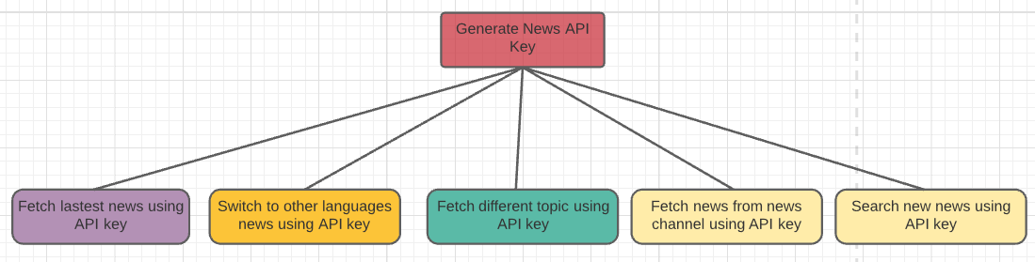
NEWS API diagram

Slide 5
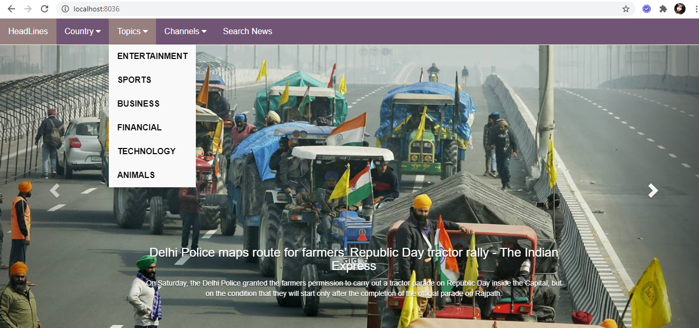
TOPICS Screenshot

Slide 6
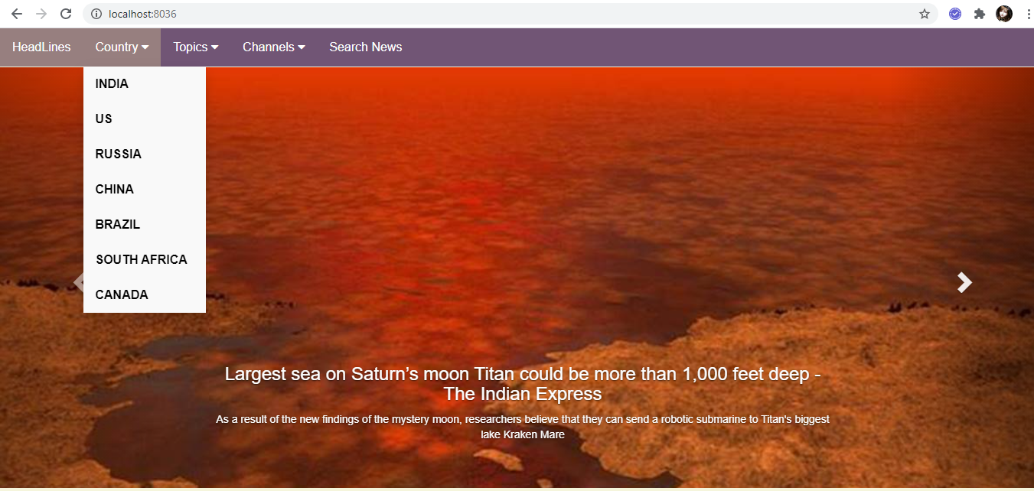
World news screenshot

Slide 7
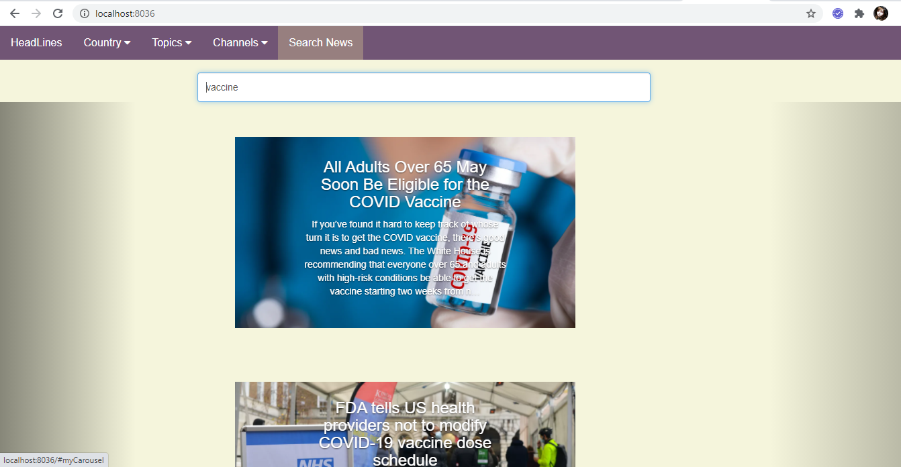
Searching for news

